Slide 1
<Customer Name> <Project Name> Kickoff
MM/DD/YYYY

Slide 2
Roles and Responsibilities
Director – <name>
Escalation and oversight
Support delivery teams to ensure customer success
Project Lead– <name>
Responsible overall project success
Supervises the work of other team members
Guides and reviews technical design
Work with PO on planning activities, requirements analysis and scope management
Full-time during first 2 weeks, part-time during other portions of engagement
Photo
*Sample only:
Adjust as necessary based on project
specifics
Photo

Slide 3
Appian Team Roles and Responsibilities
Tech Lead – <name>
Day to day project lead
Key contributor on planning activities, requirements analysis and scope management
Full-time throughout the life of the project
Delivery Team Member – <name>
Process Designer
Full-time throughout the life of the project
Delivery Team Member – <name>
Process Designer
Full-time throughout the life of the project
Photo
*Sample only:
Adjust as necessary based on project
specifics
Photo
Photo

Slide 4
Goals for Next 2 Weeks
WHY
The “Who, How and Why” of the Project
Project Charter
Establish User Personas
Project Methodology Review
The “What and When of the Project”
Establish Overall Functional Design (Functional View)
Establish Overall Solution Design (Technical View)
Create Product Backlog (Estimated & Prioritized)
Create Release Plan
Build Proof of Concepts and/or Initial Features
WHO
HOW
WHAT
WHAT
WHAT
WHEN
WHAT

Slide 5
*Sample only:
Adjust as necessary based on project
specifics
Sprint 0 Schedule
(updated daily)

Slide 7
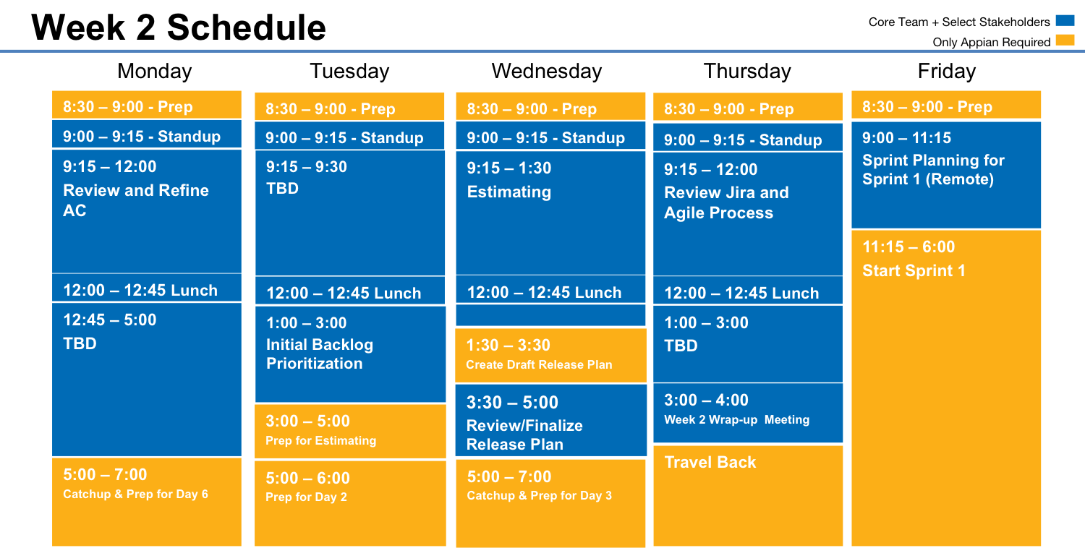

Slide 8
Cadence for First Sprint
*Sample only:
Adjust as necessary based on project
specifics

Slide 9
Core Team + Select Stakeholders
Sprint 1
Only Select Individuals
“Optional” Standing Meetings
Monday
Tuesday
Wednesday
Thursday
Friday
9:45 – 10:00 Standup
9:45 – 10:00 Standup
9:45 – 10:00 Standup
9:45 – 10:00 Standup
9:45 – 10:00 Standup
10:00 – 10:15
Standing Story Acceptance Demo
10:00 – 10:15
Standing Story Acceptance Demo
Week 1
3:00 – 5:00
Prep for Backlog Grooming
1:00 – 2:30
Backlog Grooming
3:00 – 5:00
Prep for Story Workshop
9:45 – 10:00 Standup
9:45 – 10:00 Standup
9:45 – 10:00 Standup
9:45 – 10:00 Standup
9:45 – 10:00
Standing Story Acceptance Demo
10:00 – 10:15
Standing Story Acceptance Demo
Estimation
10:00 – 10:15
10:00 – 10:15
Standing Story Acceptance Demo
10:00 – 11:00
Sprint Demo
Week 2
1:00 – 3:00
Story Workshop
1:00 – 1:15 Retro
1:15– 3:00
Sprint Planning
6:00
“Code Freeze” for Demos

