Slide 1
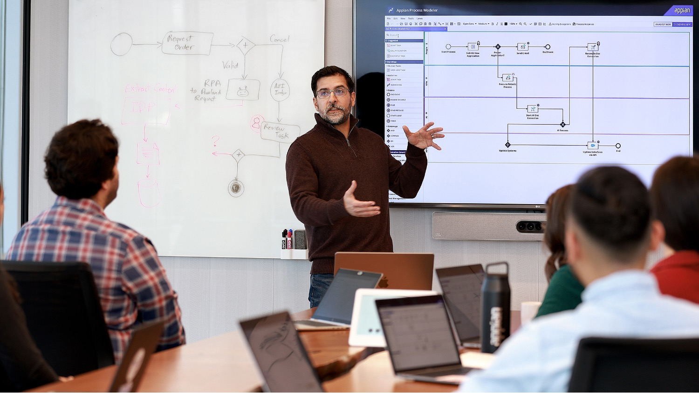
<Customer Name>
Project Kickoff / Charter
<Date>

Slide 2
Roles and Responsibilities
Director - <Name>
 | Escalation and oversight Support delivery teams to ensure customer success
Account Executive - <Name>
 | Escalation and oversight from Appian Account level
Technical Delivery Manager - <Name>
 | Responsible for Project Delivery and overall project success Part-time support on the delivery of the project including escalation and oversight
Architect - <Name>
 | Responsible for technical governance and architecture of the Appian Delivery Architectural runway activities and design pattern oversight Ensure alignment with best practices, including scalability and performance
Team Lead - <Name>
Engagement Lead on day-to-day activities Full-time throughout the life of the project
Developer - <Name>
 | Key contributor on planning activities, solution design, development, and rollout Full-time throughout the life of the project
Developer - <Name>
 | Key contributor on planning activities, solution design, development, and rollout Full-time throughout the life of the project

Slide 3
Remote Sprint 0 Ground Rules
Keep cameras on if possible
Place yourself on mute when not talking with group
Use the chat feature to ask questions without interrupting the flow of the discussion
Look for opportunities to place larger discussion items in our Parking Lot
Schedule regular break times to maintain focus

Slide 4
Project Overview

Slide 5
The How: Agile Approach

Slide 6
The How: Delivery Methodology
Sprint 0
Project Charter
Story Map
Sprint 1
Sprint 2
Sprint 3
Sprint n
Release Plan
User Personas
Architectural Prototypes
Mockups
& Functional Prototypes
High Level Design

Slide 7
Project Team Participation
Select Stakeholders
Participate in select meetings
Provide timely feedback and guidance
Provide usability testing
Core Team
Participate in all meetings
Make decisions about features
Prioritize backlog
Confirm story completion (PO)
Appian
Lead requirements conversations
Create application design
Draft and maintain backlog
Build application
‹#›

Slide 8
Goals for Sprint 0
The “Who, How and Why” of the Project
Project Charter
Establish User Personas
Agile Methodology
The “What and When of the Project”
Establish Overall Functional Design (Functional View)
Establish Overall Solution Design (Technical View)
Create Product Backlog (Estimated, Prioritized, & Acceptance Criteria)
Create Release Plan

Slide 9
Compressed 1 Week Sprint 0 Schedule

Slide 10
Compressed Sprint 0 Schedule
Core Team + SMEs
Core Team + SMEs + Stakeholders
Appian Team
Monday 5/24
Tuesday 5/25
Wednesday 5/26
Thursday 5/27
Friday 5/28
8:00 - 9:00 AM
Prep
8:00 - 9:00 AM
Prep
8:00 - 9:00 AM
Prep
8:00 - 9:00 AM
Prep
8:00 - 9:00 AM
Prep
9:00 - 9:30 AM
Project Kick Off
9:00 AM - 12:00 PM
Story Map Confirmation &
Initial Prioritization
9:00 AM - 12:00 PM
Story Refinement
9:00 - 10:30 AM
Story Refinement
9:00 AM - 10:30 AM
Initial Release Planning Prep
9:30 - 10:30 AM
Collaborative Charter & Team Working Agreement
10:30 AM – 12:00 PM
Architecture Documentation
10:30 AM - 12:00 PM
Release Planning
10:30 AM - 12:00 PM
Current State Demo
12:00 – 12:45 PM Lunch
12:00 – 12:45 PM Lunch
12:00 – 12:45 PM Lunch
12:00 – 12:45 PM Lunch
12:00 – 12:45 PM Lunch
1:00 - 5:00 PM
Review Personas & Story Map CoCreation
1:00 - 5:00 PM
Story Refinement
1:00 - 4:30 PM
Story Refinement
1:00 – 5:00 PM
Estimation
1:30 – 2:30 PM
Present Release Plan
2:30 – 3:30 PM
Sprint Planning
4:30 - 5:00 PM
Review Charter
3:30 - 5:00 PM
Start Sprint 1
5:00 – 7:00 PM
Catchup & Prep for Day 2
5:00 – 7:00 PM
Catchup & Prep for Day 3
5:00 – 7:00 PM
Catchup & Prep for Day 4
5:00 – 7:00 PM
Catchup & Prep for Day 5

Slide 11
Standard Sprint 0 Schedule

Slide 12
Sprint 0 Schedule Week 1
Core Team + SMEs
Core Team + SMEs + Stakeholders
Appian Team
Monday 5/17
Tuesday 5/18
Wednesday 5/19
Thursday 5/20
Friday 5/21
8:30 - 9:00 AM
Prep
8:30 - 9:00 AM
Prep
8:30 - 9:00 AM
Prep
8:30 - 9:00 AM
Prep
8:30 - 9:00 AM
Prep
9:00 - 9:30 AM
Project Kick Off
9:00 - 9:15 AM
Daily Standup
9:00 - 9:15 AM
Daily Standup
9:00 - 9:15 AM
Daily Standup
9:00 - 9:15 AM
Daily Standup
9:30 AM - 12:00 PM
Collaborative Charter & Team Working Agreement
9:15 AM - 12:00 PM
Story Mapping
9:15 AM - 12:00 PM
Story Refinement
9:15 AM - 12:00 PM
Story Refinement
9:15 AM - 12:00 PM
Architectural and/or Functional Prototypes; Draft Data Model for Record Types
12:00 – 12:45 PM Lunch
12:00 – 12:45 PM Lunch
12:00 – 12:45 PM Lunch
12:00 – 12:45 PM Lunch
12:00 – 12:45 PM Lunch
1:00 - 5:00 PM
Solution Personas,
Review existing artifacts, Current State Demo
1:00 - 5:00 PM
Story Mapping / Initial Refinement
1:00 - 5:00 PM
Story Refinement
1:00 - 5:00 PM
Story Refinement
1:00 - 3:00 PM
Application Architecture and Integrations with IT
3:00 - 4:00 PM
Week 1 Wrap-up Meeting
5:00 – 7:00 PM
Prep for Day 2
5:00 – 7:00 PM
Prep for Day 3
5:00 – 7:00 PM
Prep for Day 4
5:00 – 7:00 PM
Prep for Day 5

Slide 13
Sprint 0 Schedule Week 2
Core Team + SMEs
Core Team + SMEs + Stakeholders
Appian Team
Monday 5/24
Tuesday 5/25
Wednesday 5/26
Thursday 5/27
Friday 5/28
8:30 - 9:00 AM
Prep
8:30 - 9:00 AM
Prep
8:30 - 9:00 AM
Prep
8:30 - 9:00 AM
Prep
8:30 - 9:00 AM
Prep
9:00 - 9:15 AM
Daily Standup
9:00 - 9:15 AM
Daily Standup
9:00 - 9:15 AM
Daily Standup
9:00 - 9:15 AM
Daily Standup
9:00 - 9:15 AM
Daily Standup
9:15 AM - 12:00 PM
Backlog Prioritization
9:15 AM - 12:00 PM
Sprint 1 & 2 Story Writing
9:15 AM - 12:00 PM
Estimation
9:15 - 10:00 AM
Review Charter
9:15 AM - 6:00 PM
Start Sprint 1
10:00 AM - 12:00 PM
Release Planning Prep
12:00 – 12:45 PM Lunch
12:00 – 12:45 PM Lunch
12:00 – 12:45 PM Lunch
12:00 – 12:45 PM Lunch
1:00 - 5:00 PM
Sprint 1 & 2 Story Writing
1:00 – 5:00 PM
Design Stories & Prep for Estimation
1:00 – 3:30 PM
Estimation
1:00 – 2:00 PM
Present Release Plan
3:30 – 5:00 PM
Release Planning
2:00 - 3:00 PM
Review Working Agreement
5:00 – 7:00 PM
Prep for Day 7
5:00 – 7:00 PM
Prep for Day 8
5:00 – 7:00 PM
Prep for Day 9
3:00 – 4:00 PM
Sprint Planning

Slide 14
Project Risks
Risk | Likelihood | Impact | Mitigation | Owner

Slide 15
Critical Success Factors
Containing Scope to focus on minimum foundational application
Adopting agile methodologies across a geographically dispersed team
Broad stakeholder participation and feedback early on

Slide 16
Sprint Cadence

Slide 17
Development Sprint Schedule
Core Team + SMEs
Core Team + SMEs + Stakeholders
Appian Team
Monday
Tuesday
Wednesday
Thursday
Friday
9:00 – 9:15 Daily standup
9:00 – 9:15 Daily standup
9:00 – 9:15 Daily standup
9:00 – 9:15 Daily standup
9:00 – 9:15 Daily standup
2:00 - 3:00 PM
Design Workshop
10:00-11:30 AM
Backlog Refinement
2:00 - 3:00 PM
Architect Design Review
10:00-11:30 AM
Backlog Refinement
10:00-10:30 AM
Story Acceptance Demo
Week 1
Deploy completed story to TEST
Deploy completed story to TEST
Deploy completed story to TEST
Deploy completed story to TEST
9:00 – 9:15 Daily standup
9:00 – 9:15 Daily standup
9:00 – 9:15 Daily standup
9:00 – 9:15 Daily standup
9:00 – 9:15 Daily standup
2:00 - 3:00 PM
Design Workshop
10:00-11:30 AM
Backlog Refinement
2:00 - 3:00 PM
Architect Design Review
10:00-11:30 AM
Backlog Refinement
1:00 - 2:00 PM
Sprint Review
Week 2
2:00 - 3:00 PM
Story Estimation
2:00 - 3:30 PM
Sprint Planning / Retro
6:00 PM
Code Freeze for Demos
Deploy completed story to TEST
Deploy completed story to TEST
Deploy completed story to TEST

Slide 18
Where does this time come from?
Core Team + SMEs
Core Team + SMEs + Stakeholders
Appian Team
Monday
Tuesday
Wednesday
Thursday
Friday
9:00 Daily standup
9:00 Daily standup
9:00 Daily standup
9:00 Daily standup
9:00 Daily standup
9:15 - 10:45
Refine backlog
9:15 - 10:45
Refine backlog
Week 1
2:00 - 3:00
Architect Design Review
Deploy completed story to TEST
Deploy completed story to TEST
Deploy completed story to TEST
Deploy completed story to TEST
9:00 Daily standup
9:00 Daily standup
9:00 Daily standup
9:00 Daily standup
9:00 Daily standup
9:15 - 10:45
Refine backlog & set next sprint stories
9:15 - 10:45
Refine backlog
1:00 - 2:00 PM
Sprint Review
Week 2
10:45 Assign Stories
2:00 - 2:30 Retro
2:00 - 3:00
Story Estimation
2:00 - 3:00
Architect Design Review
2:30 - 5:00
Review designs
Deploy completed story to TEST
Deploy completed story to TEST
Deploy completed story to TEST

Slide 19
Questions?

Slide 20
Thank you.

