Slide 1
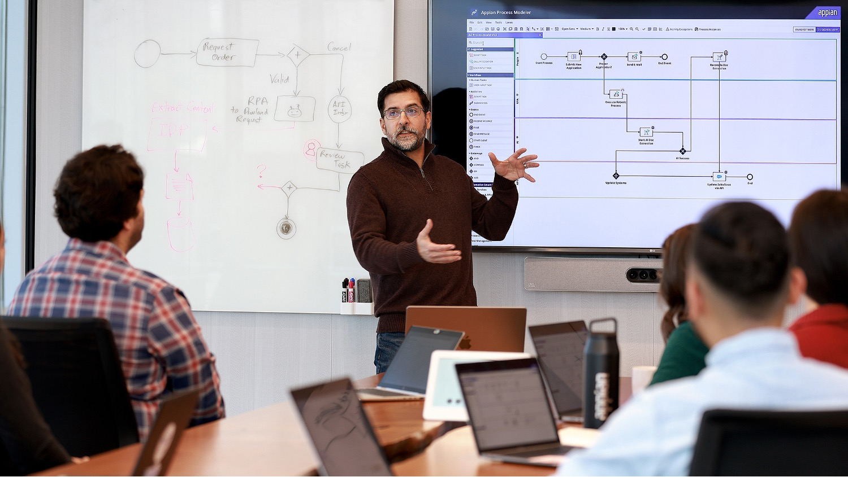
<Project Name> Project Charter
Presenter | Date
Presenter Title

Slide 2
The What
Project Name:
Project Timeframe:
10 weeks
Sprint 0 (Initiation): 1 Week
Implementation: 9 Weeks
Project Pitch:

Slide 3
The Why
Primary Goals:

Slide 4
The Why: Quantifiable Success Measures
 | Example
Measure what we will measure | Ex: Time it takes to book a reservation | Visibility on discrepancies | Define categories of discrepancies | Eliminate paper forms
Source source for measurement | Ex: Self-reported | Self-reported | Self-reported
Benchmark what the situation is now | Ex: 2-3 hours a week | No formal visibility | 4 categories | 5 forms, 3 printed
Minimum Target the minimum acceptable value for the measurement | Ex: 10 mins a week | Visibility for Warehouse, Quality, Planning | 3 consolidated categories | 1 form (print for records)
Desired Target the desired target value for the measurement | Ex: 5 mins a week | Visibility for management |  | 0 forms (all electronic)

Slide 5
The Why: Quantifiable Success Measures
Measure what we will measure
Source source for measurement
Benchmark what the situation is now
Minimum Target the minimum acceptable value for the measurement
Desired Target the desired target value for the measurement

Slide 6
The Why: Quantifiable Success Measures
Appian Core Team
Envision
Build
SMES
Appian Team
Stakeholders
Sponsor
Stakeholders
SMEs

Slide 7
The When: Project Timeline
Project
Planning
Initiation
Sprint 1
Sprint 2
Sprint 3
Sprint 4
MVP!
May 24
May 31
June 14
June 28
July 12
July 26
10 Weeks

Slide 8
Thank you.

