Slide 1
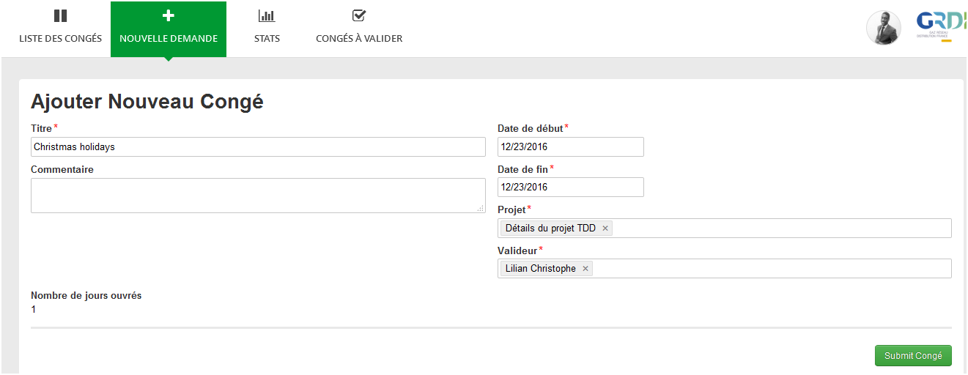
Start date
End date
Task Assigner’s project
Notes:
From QuickApp menu « Nouvelle demande » (Day off Request) you fill a form with Start date, end date, and the project team you’re part of. These inputs are sent to validators (tasks assignees) in menu « Congés à valider »

Slide 2
Notes:
All validation tasks appear in menu « Congés à valider » (Current tasks). In this example, the two current users (tasks assigners) belong to the same team and both ask for a day off on December 23rd.

Slide 3
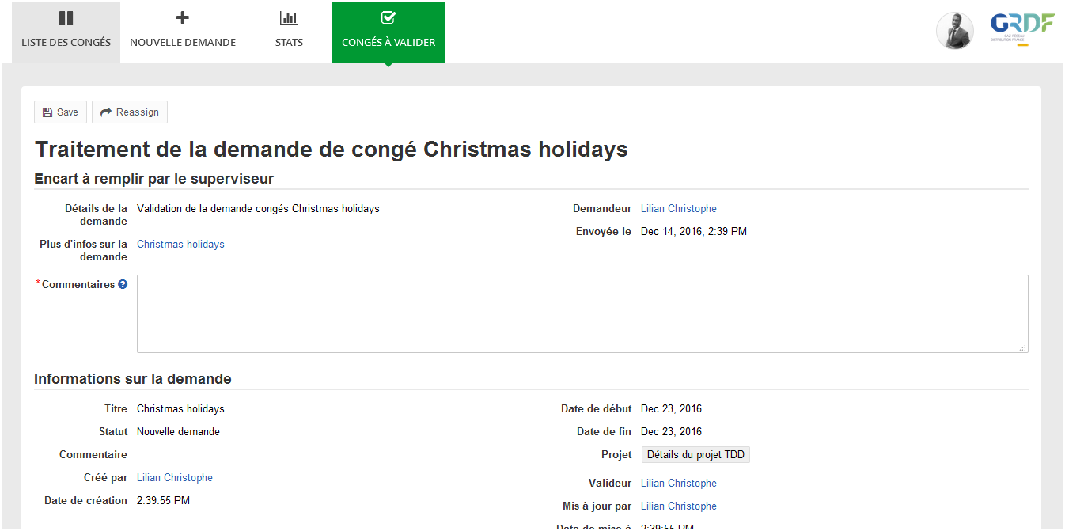
Form reserved to validator (task assignee)
Read-only form with inputs from « Nouvelle demande »
Warning : two users have requested at least 1 day off at the same date
Notes:
When you select a request having a date in common with another request, there’s a form for the validator. The warning message I try to implement should appear on top of the form as shown in this slide

